Slide 1


TENET+: a tool for reconstructing gene networks by integrating single cell expression and chromatin accessibility data
Hyeon Kyu Kim
Lab. for single Cell System
Soongsil University
Advised by Prof. Junil Kim

Slide 2
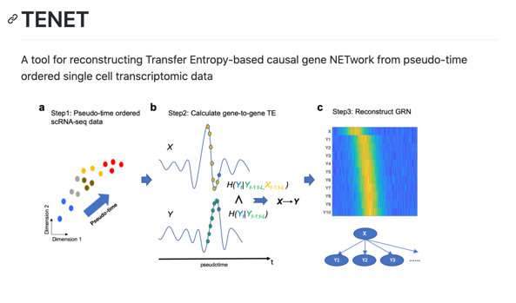
Kim et al., Nucleic Acids Research. (2021)
mESC
tSNE 2
Neural progenitor
Pluripotency + neural differentiation
tSNE 1
pseudotime

Slide 3
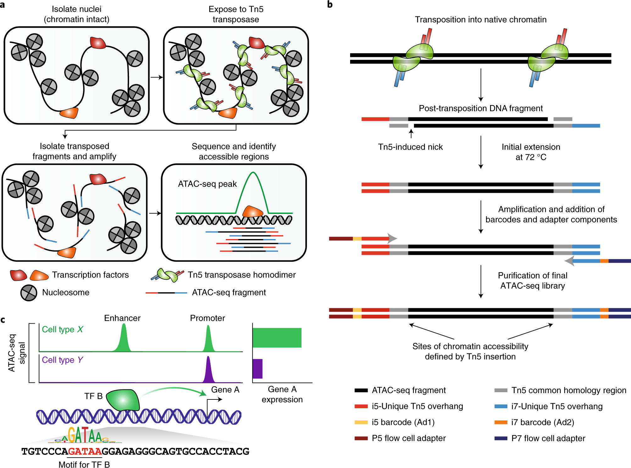
Single cell ATAC sequencing

Slide 4
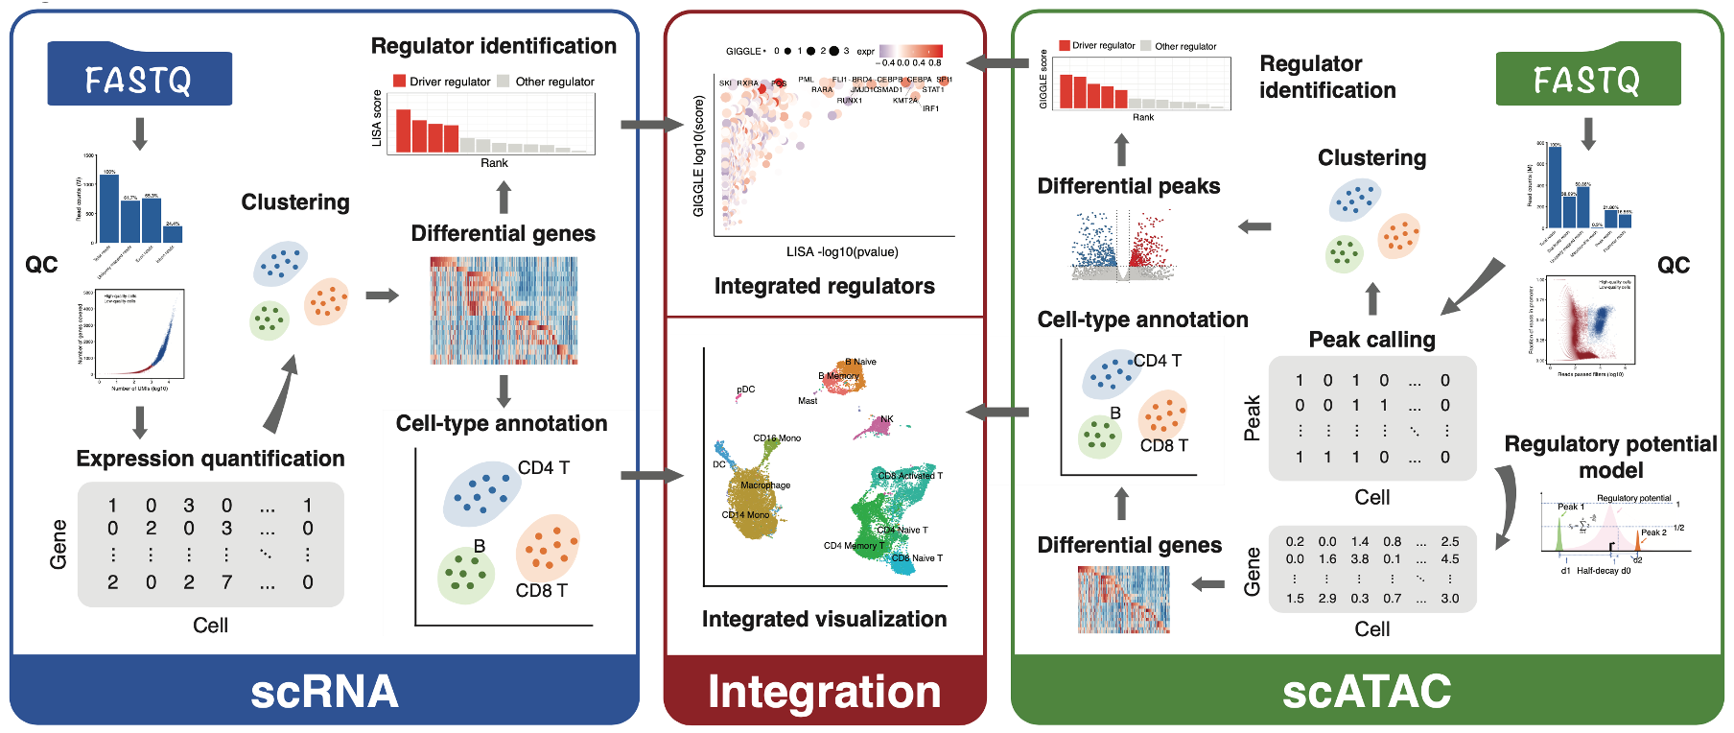
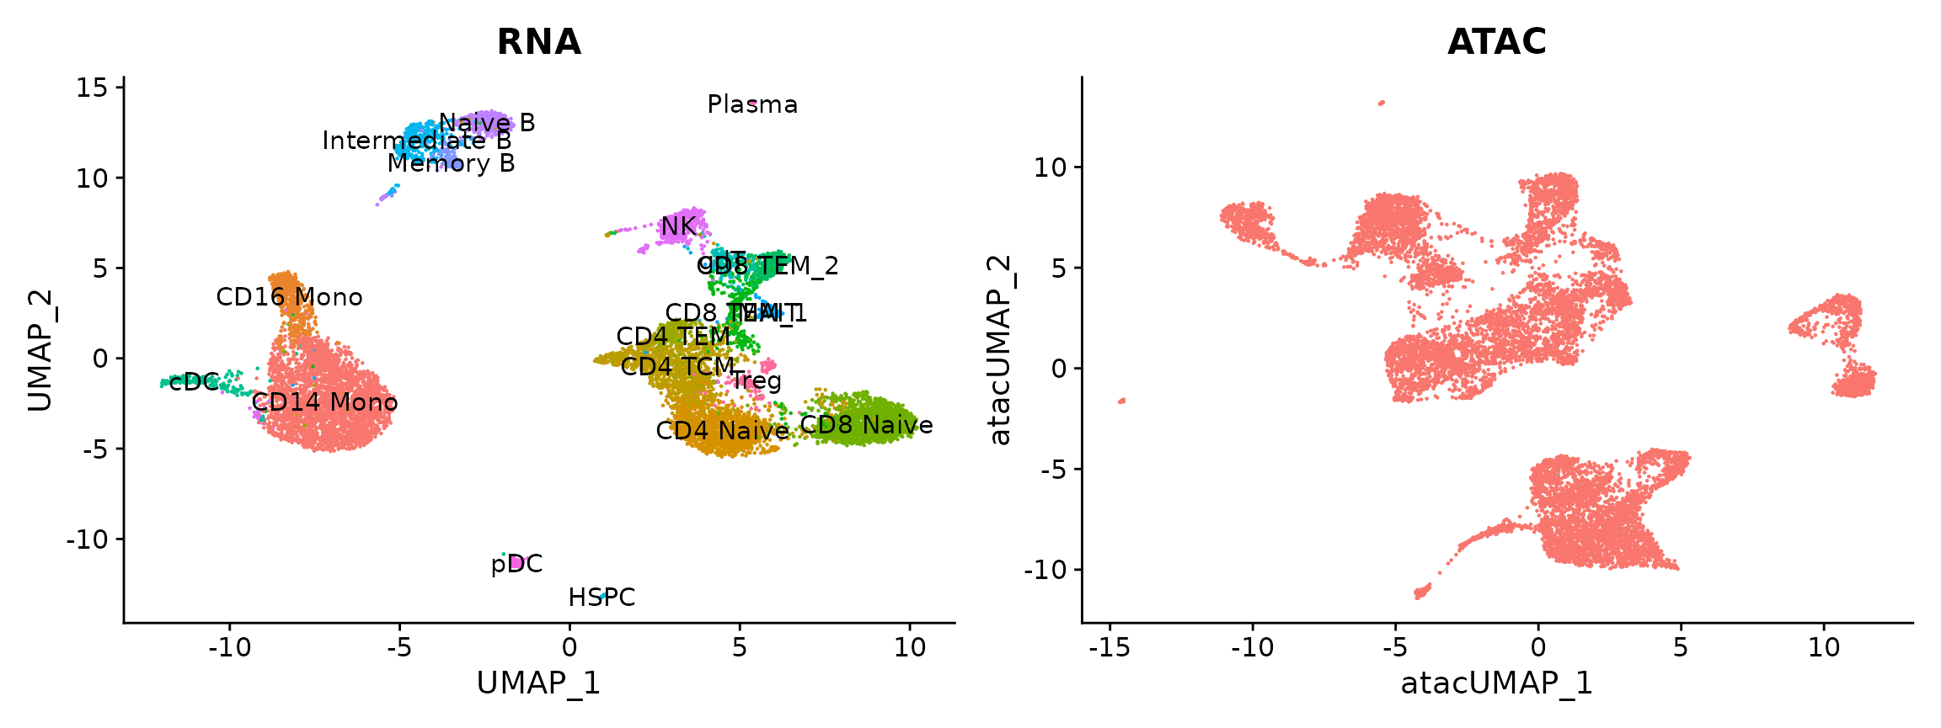
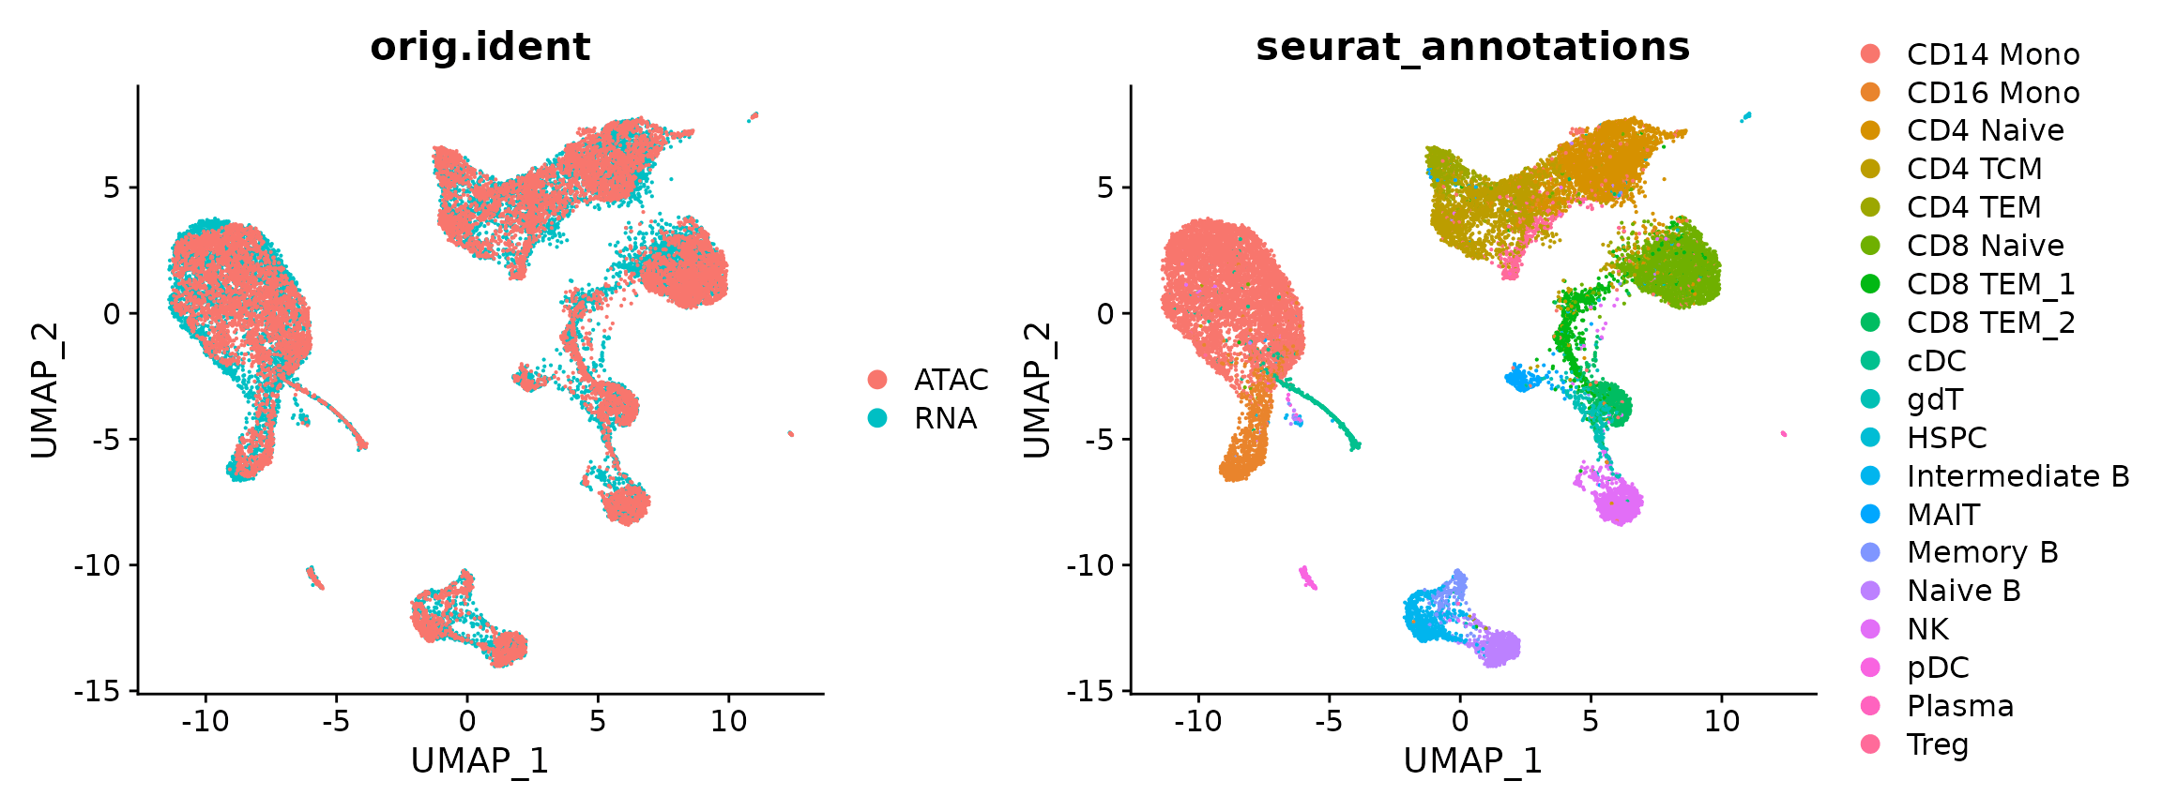
Single cell ATAC sequencing : Analysis with Signac
https://github.com/liulab-dfci/MAESTRO
Single-cell chromatin state analysis with Signac
Nature methods 01 Nov. 2021

Slide 5
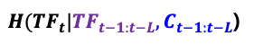
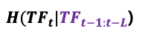
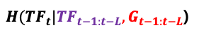

TENET+ workflow
Step 1 : Pseudo-time ordered
scRNA-seq & scATAC-seq data
Step 2 : Calculate TF-to-gene, peak TE
Step 3 : Trimming the targets and Downstream analysis
Chromatin accessibility
Indirect Trimming
Distance Trimming
TF
TF
1M bp
TE
G1
G2
Gene
Gene expression
TF to Gene
Peak to Gene
Pseudo-time
TF-gene-peak linkage
Pseudotime
Dimension 2
ATAC
$H({TF}_{t}|{TF}_{t−1:t−L}{,G}_{t−1:t−L}$)
RNA
Dimension 1
$H({TF}_{t}|{TF}_{t−1:t−L}$)
gene 1 gene 2 gene 3 …..
chr 1 chr 2 chr 3 chr4 …..
TF -> Gene expression
cell 1
Gene
expression
Open
chromatin
cell 2
Pseudotime
Regulatory Triplet
$H({TF}_{t}|{TF}_{t−1:t−L}{,C}_{t−1:t−L}$)
TF
$H({TF}_{t}|{TF}_{t−1:t−L}$)
TF -> Chromain accessibility
G
P
Chromain accessibility -> Gene expression

Slide 6
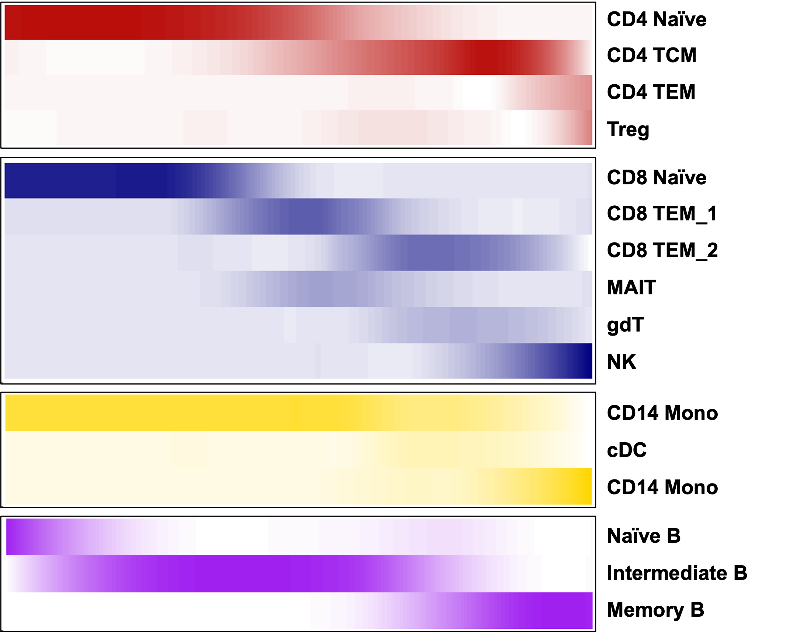
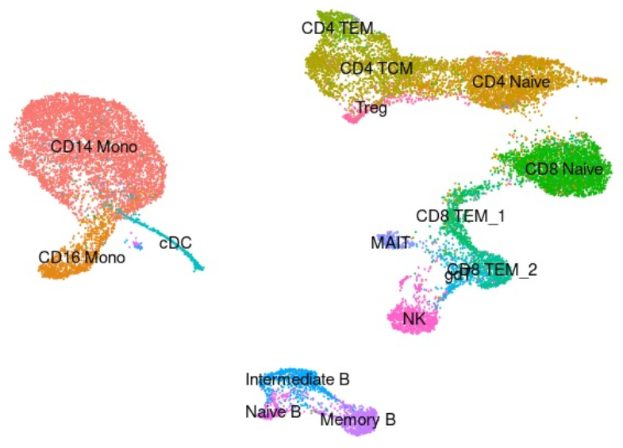
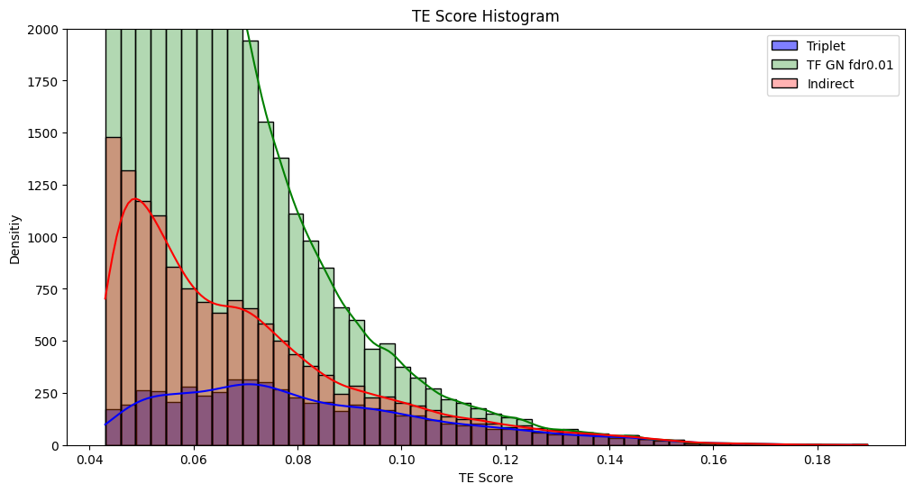
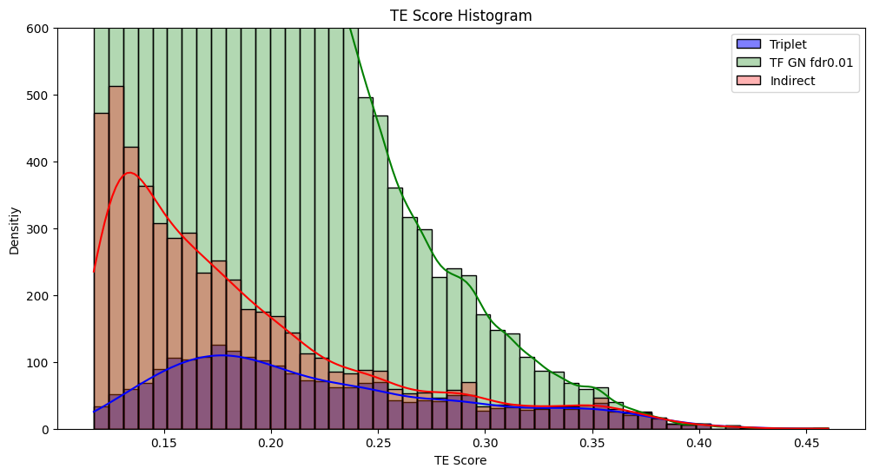
A. Input dataset for TENETPLUS by using PBMC Multiome data
Regulatory Triplet
TF
G
P
< CD4 >
< B cell >

Slide 7
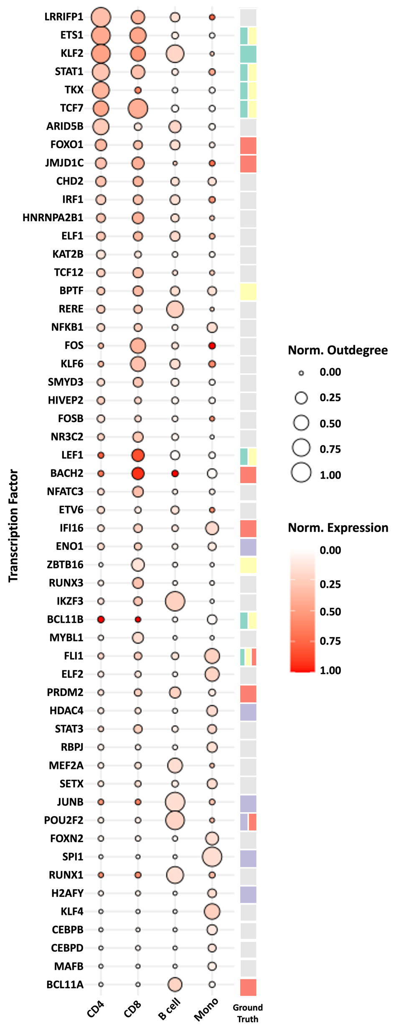
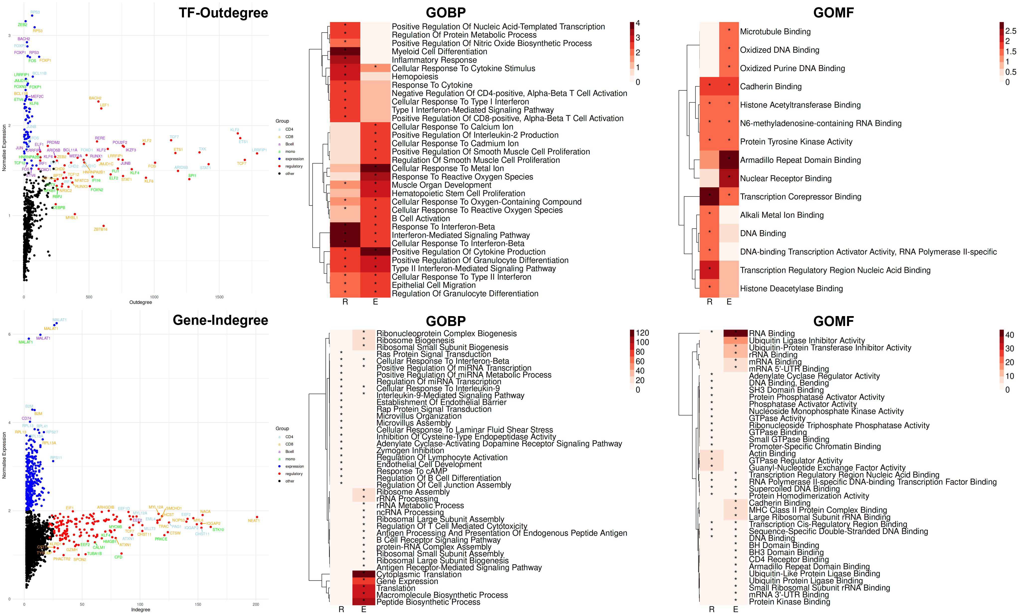
B. Top regulatory triplet TF of 4 cell types of PBMCs predicted by TENET+
CD4
CD8
B cell
Monocyte

Slide 8
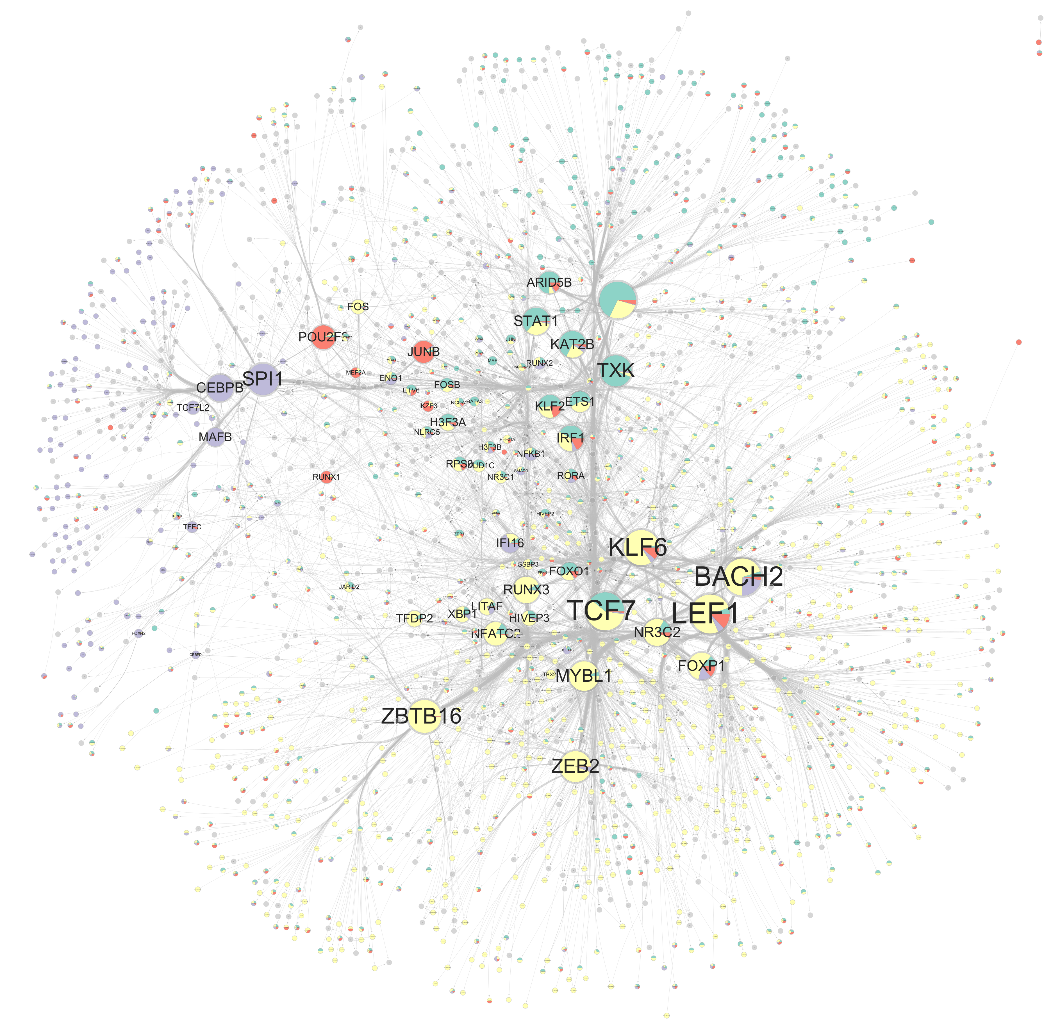
C. TENET+ detect cell type specific TF’s target gene & peak
TFs for four cell types
target genes for four cell types
TF-TG links for four cell types
LRRFIP1
TF A_CD4

Slide 9
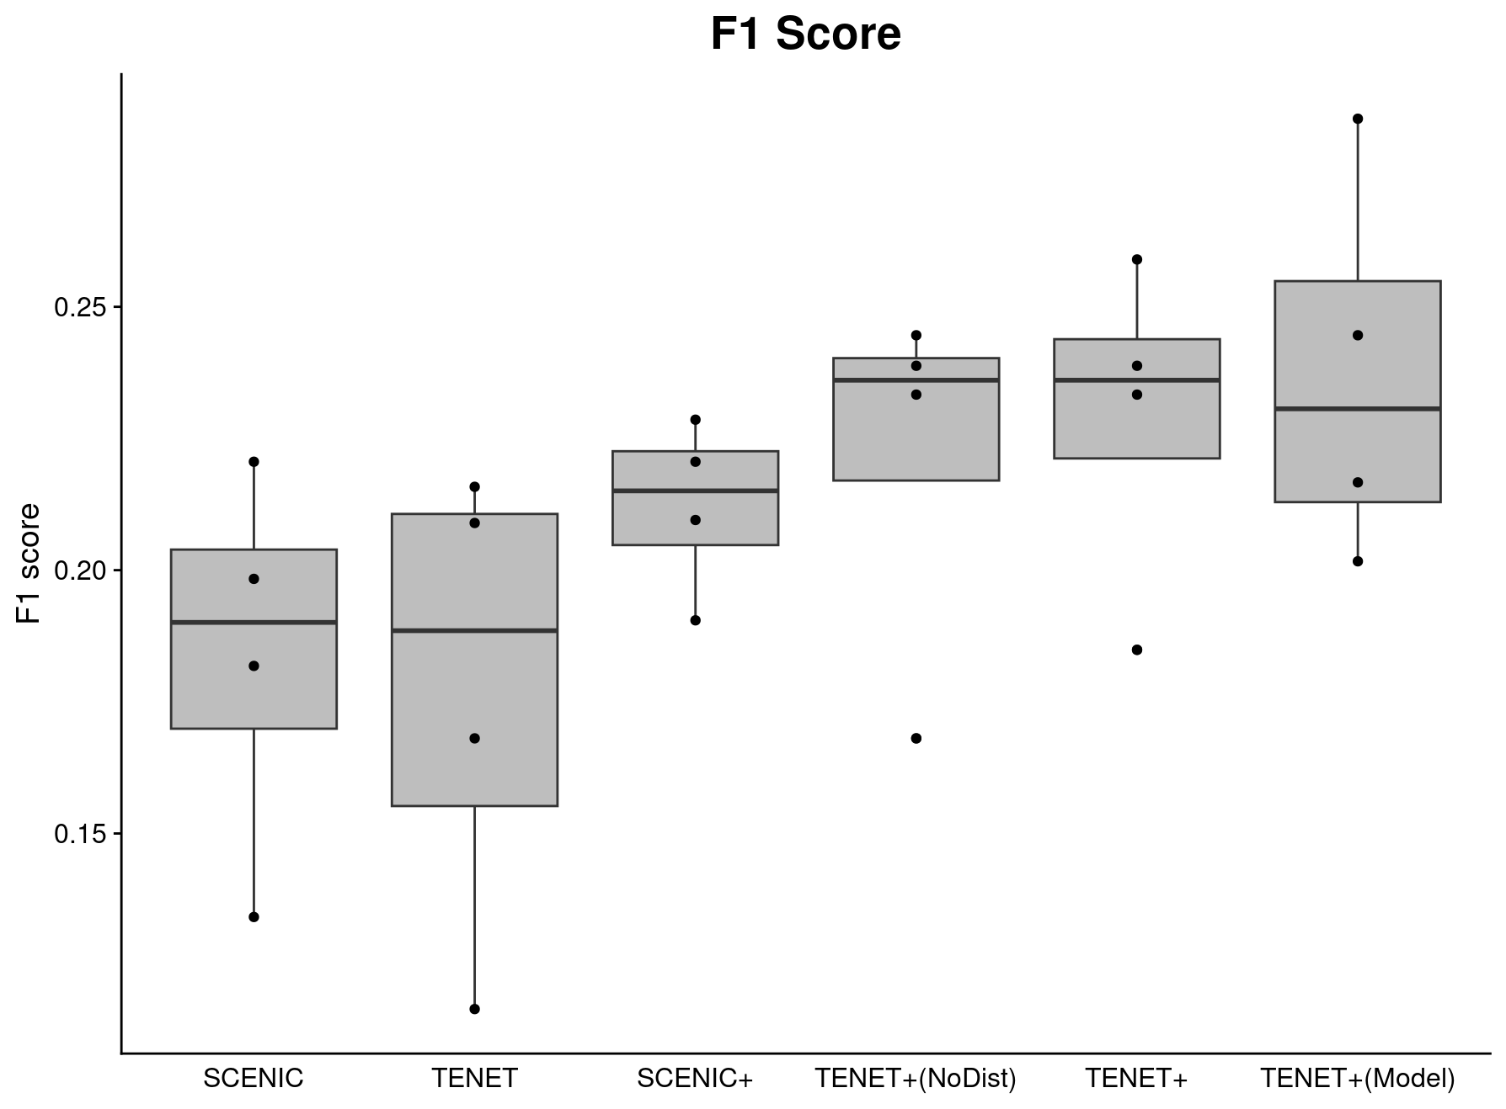
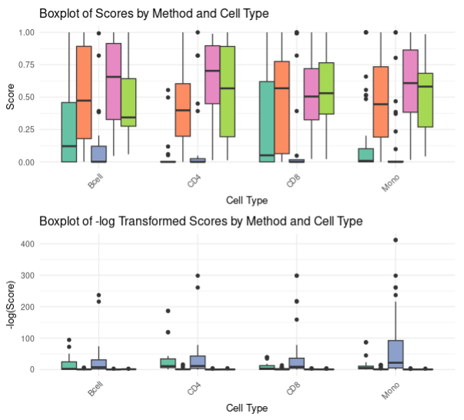
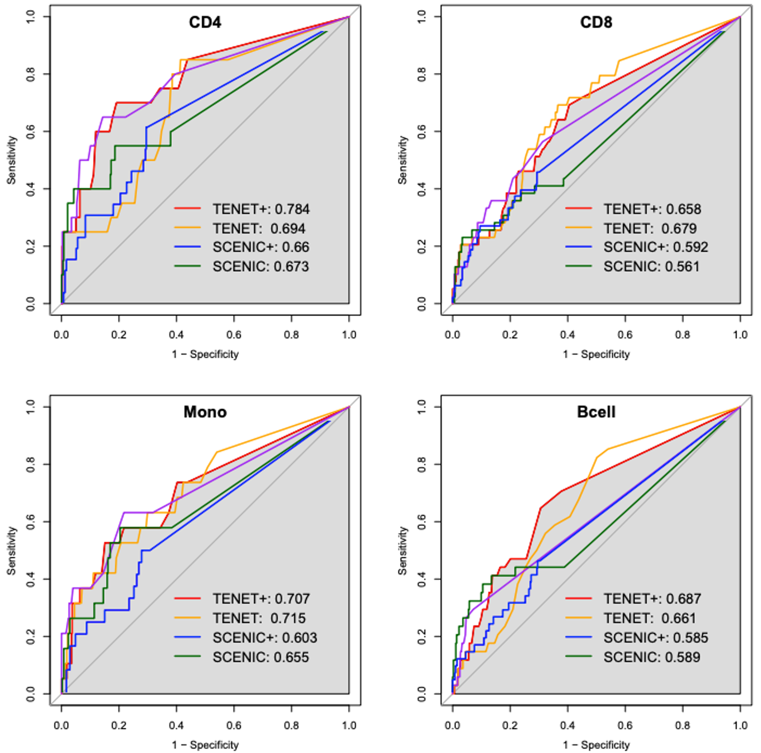
D. TENET+ shows superior performance to find key regulators
ROC curve
Transcription Factor
F1 score
Chip-seq hypergeometric test
0.25
F1 score
0.20
0.15
SCENIC
TENET
SCENIC+
TENET+
(Distance X)
TENET+

Slide 10
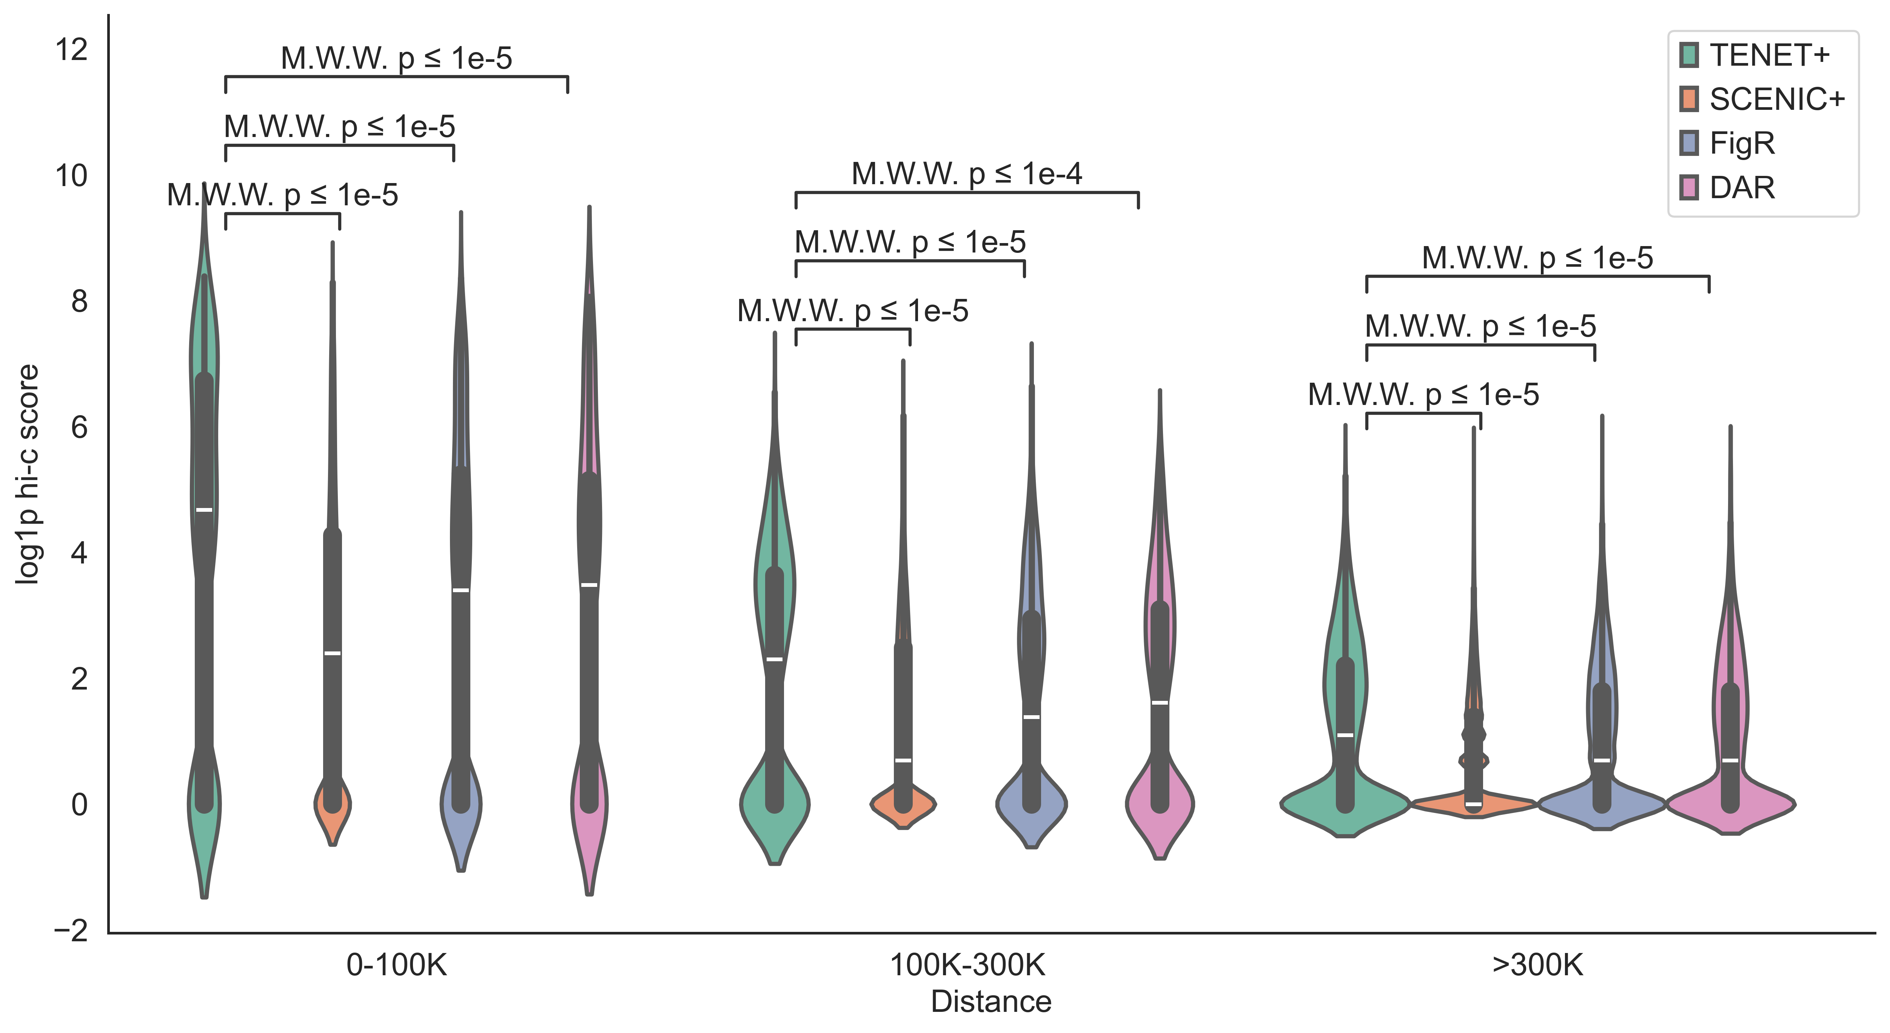
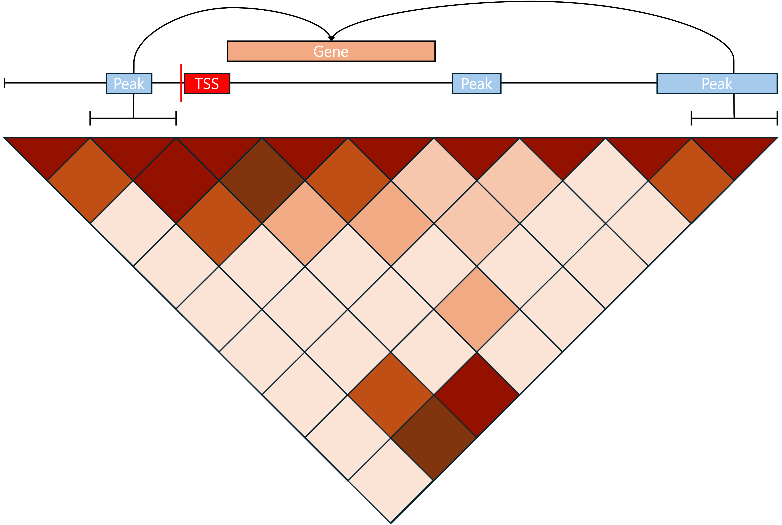
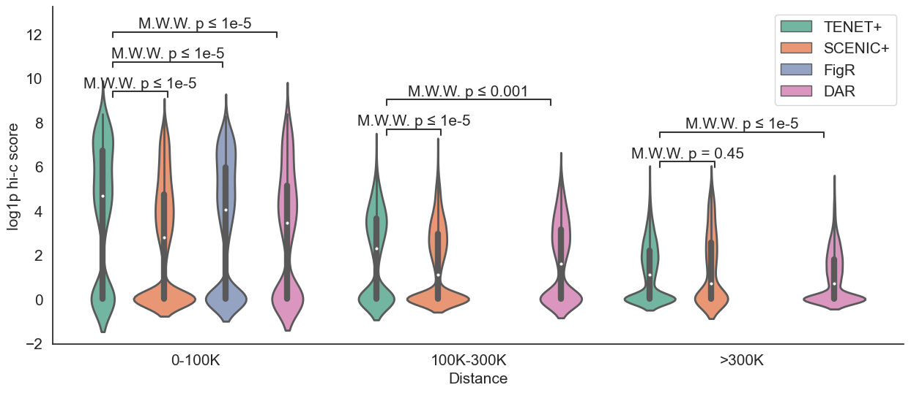
D. TENET+ shows superior performance to find key regulators
Hi-C dataset
CD4
CD8

Slide 11
Hackathon Goal
- Stimulate GRN validation
- packaging TENET +
- Local TE

